Slide 1

Relational Databases
ER Modeling

Slide 2
Types of Entities
Strong entity
Weak entity

Slide 3
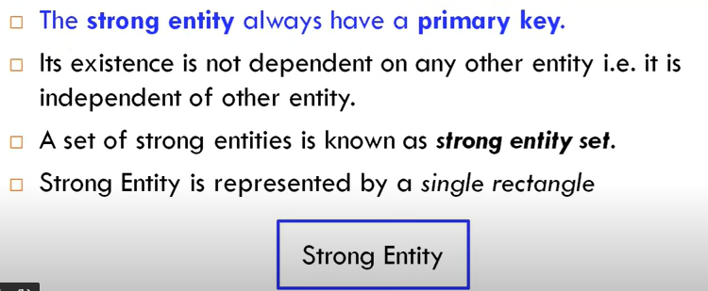
Strong entity

Slide 4
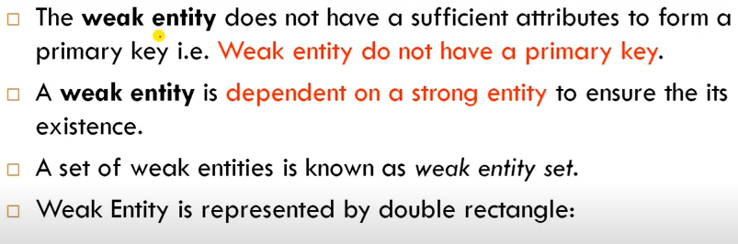
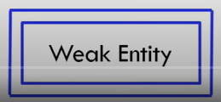

Slide 5
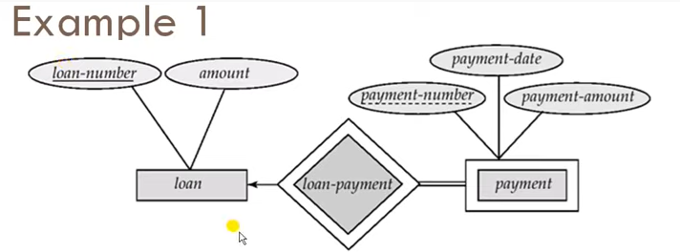
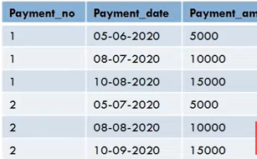
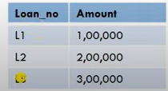
Example

Slide 6
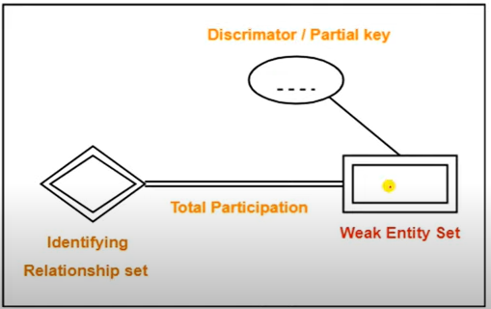
Representation

Slide 7
Example
name is almost a key for football players, but there might be two with the same name.
number is certainly not a key, since players on two teams could have the same number.
But number, together with the team name related to the player by Plays-on should be unique.

Slide 8
In E/R Diagrams(point out mistakes )
name
number
name
Players
Plays-
on
Teams
Double diamond for supporting many-one relationship.
Double rectangle for the weak entity set.

Slide 9
In E/R Diagrams
name
Number
-----------
name
Players
Plays-
on
Teams
Double diamond for supporting many-one relationship.
Double rectangle for the weak entity set.

Slide 10
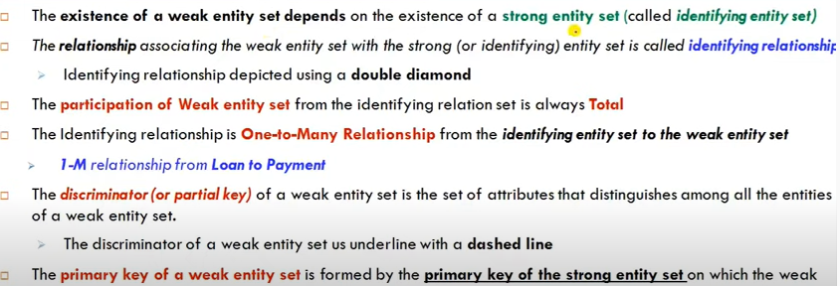
Weak and strong entities

Slide 11
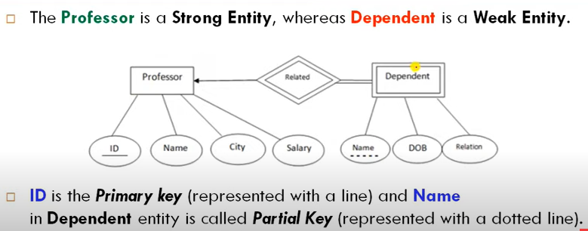
Example 2

Slide 12
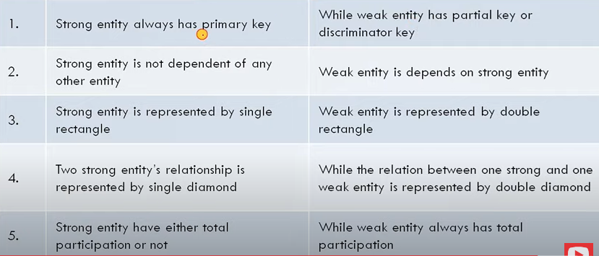
Differences
Strong entity
Weak entity

Slide 13
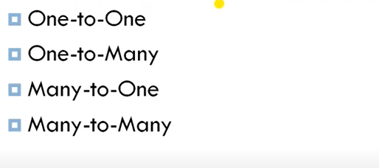
Mapping cardinalities

Slide 14
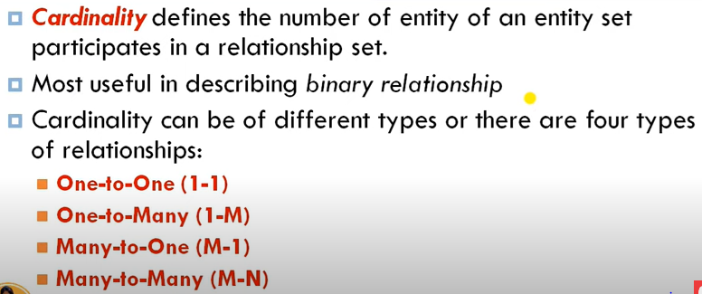
Mapping cardinalities

Slide 15
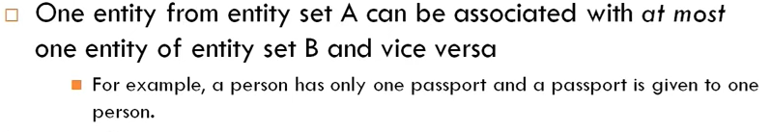
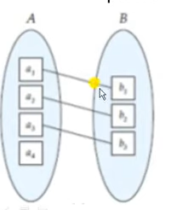
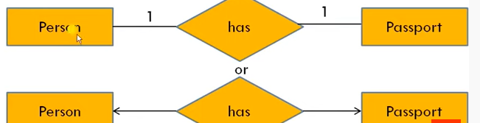
One to one

Slide 16
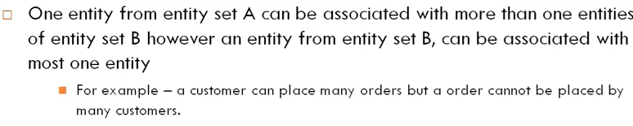
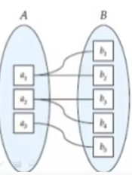
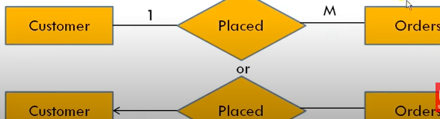
One to many

Slide 17
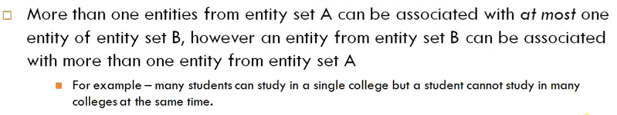
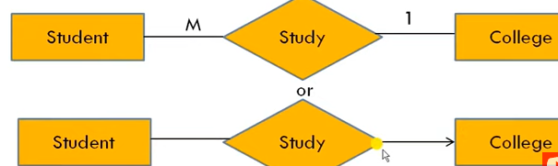
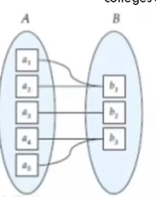
Many to one

Slide 18
In Pictures:
many-one

Slide 19
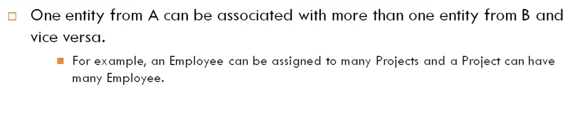
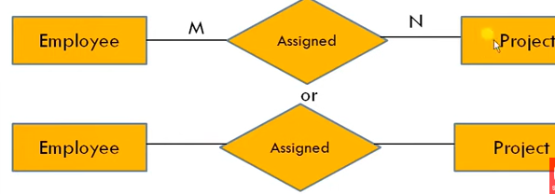
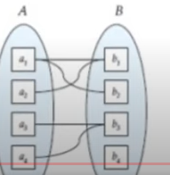
Many to many

Slide 20
In Pictures:
many-many

Slide 21
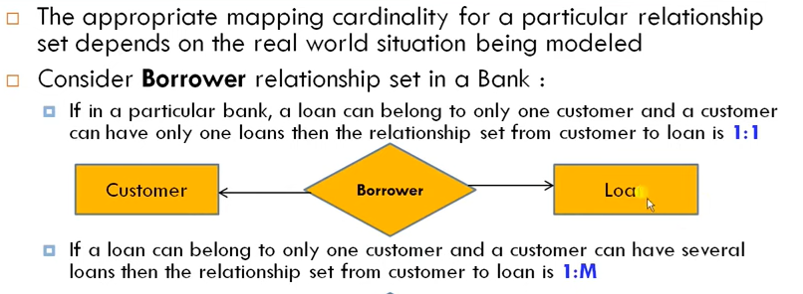

How to choose relationship

Slide 22
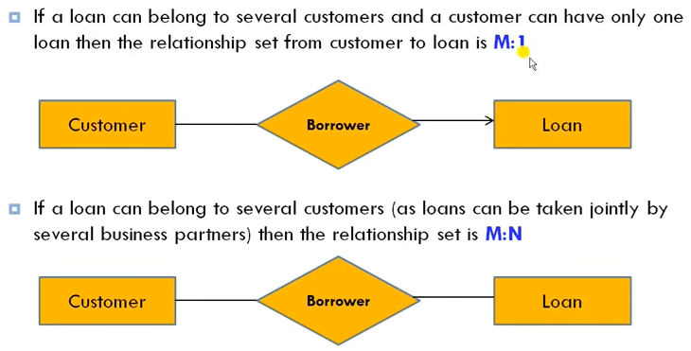
How to choose relationship

Slide 23
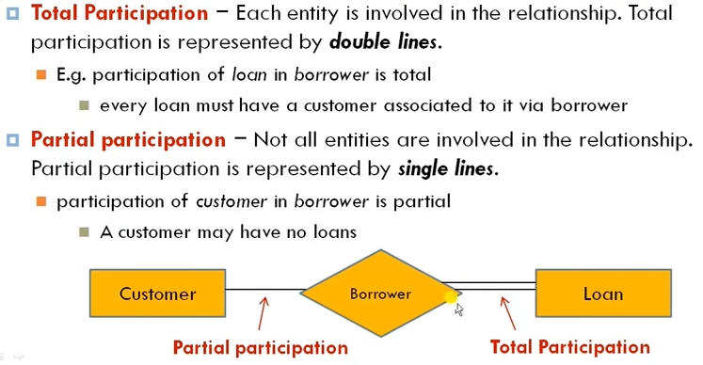
Participation constraints

Slide 24
Design Techniques
Avoid redundancy.
Limit the use of weak entity sets.
Don’t use an entity set when an attribute will do.

Slide 25
Avoiding Redundancy
Redundancy occurs when we say the same thing in two or more different ways.
Redundancy wastes space and (more importantly) encourages inconsistency.
The two instances of the same fact may become inconsistent if we change one and forget to change the other.

Slide 26
Example: Good
name
name
addr
ManfBy
Colddrinks
Manfs
This design gives the address of each manufacturer exactly once.

Slide 27
Example: Bad
name
name
addr
ManfBy
Coldrinks
Manfs
manf
This design states the manufacturer of a cold drinks twice: as an attribute and as a related entity.

Slide 28
Example: Bad
name
manf
manfAddr
Cold drinks
This design repeats the manufacturer’s address once for each cold drinks and loses the address if there are temporarily no colddrinks for a manufacturer.

